Slide 1


XAMPP and LAMP
Installing, Configuring, Running XAMP and LAMP
Mario Peshev
Technical Trainer
http://peshev.net
Software University
http://softuni.bg

Slide 2


Table of Contents
What is XAMPP?
XAMP - advantages
Download and Install XAMPP
XAMPP Control Panel
XAMPP Directories
Configuring XAMPP
LAMP: PHP, Apache and MySQL in Linux Environment

Slide 3

What is XAMPP
Apache, MySQL, PHP, Perl

Slide 4
What is XMAPP?
XAMPP (/ˈzæmp/ or /ˈɛks.æmp/) is a free and open source cross-platform web server solution stack package, consisting mainly of the Apache HTTP Server, MySQL database, and interpreters for scripts written in the PHP and Perl programming languages.

Slide 5
Etymology
XAMPP’s name is an acronym for:
X (to be read as “cross”, meaning cross-platform
Apache HTTP Server
MySQL
PHP
Perl

Slide 6

Advantages

Slide 7

Why use XAMPP?
The most popular PHP developer package
For Windows, Mac OS X & Linux
Easy installation and configuration
Completely free of charge

Slide 8

Download and Install

Slide 9
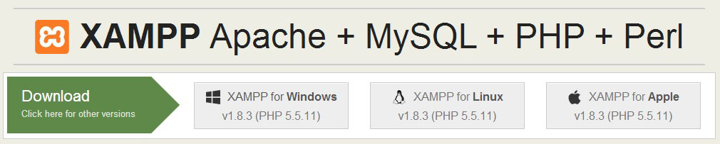
Download and Install
Go to: https://www.apachefriends.org/download.html
Download the installer (you may need to run it as administrator)
Usual windows installation Next->Next->Finish
It will install itself as a tray icon

Slide 10
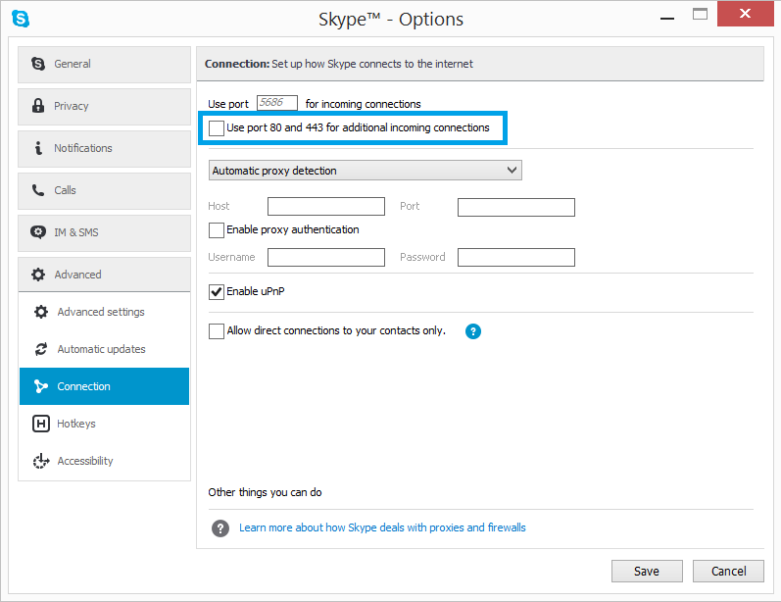
Collision with Skype

Slide 11
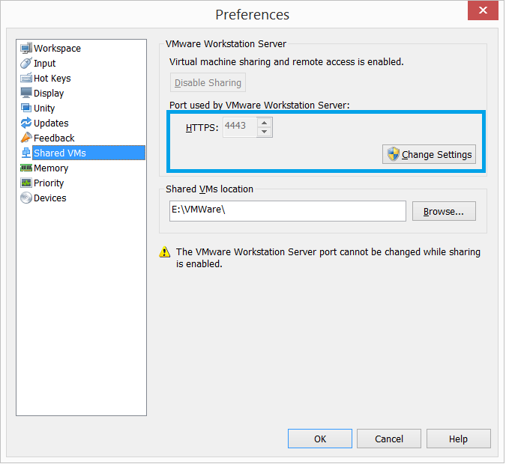
Collision with VMWare

Slide 12
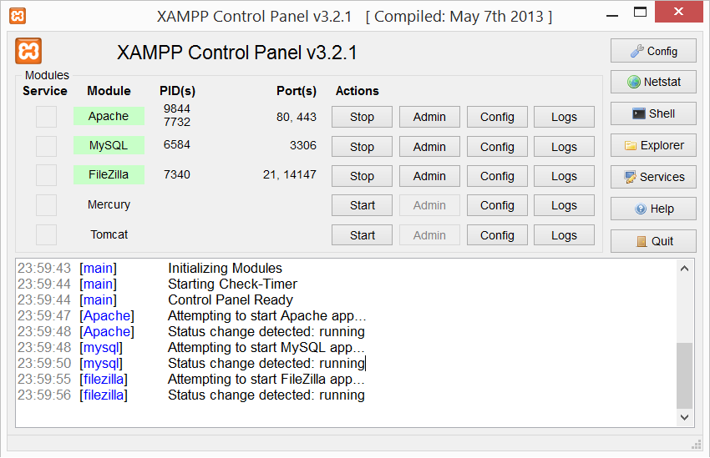
Control Panel
Used ports
Windows process identifier
System messages

Slide 13
Collision with other Web Server
There may be WAMP or IIS installed too
The best solution is to change the port
From the Tray Icon, left click and
Go to .\apache\conf -> httpd.conf
Search for “Listen 80”
Replace with “Listen 8080” for example
Access http://localhost:8080/

Slide 14

XAMPP Directories

Slide 15
Directories
./htdocs – location of public html files
./apache – location of configuration
./mysql – location of MySQL database

Slide 16

Configuration

Slide 17

Configuration files
Apache configuration file (httpd.conf): .\apache\conf\httpd.conf
PHP configuration file (php.ini): .\apache\bin\php.ini
MySQL configuration file (my.cnf): .\mysql\bin\my.cnf

Slide 18

LAMP
Linux, Apache, MySQL, PHP

Slide 19
LAMP
LAMP is an open source Web development platform that uses Linux as the operating system, Apache as the Web server, MySQL as the relational database management system and PHP as the object-oriented scripting language.

Slide 20
Download and Install on Ubutntu
Open terminal, then just write: sudo apt-get install lamp-server^
Location of web page: /var/www
Make your first page and then test with localhost

Slide 21


Summary
We discussed the WAMPP:
Downloading and Installation
Configuration
Collision with other software
We discussed the LAMP:
Downloading and Installation
PHP & MySQL

Slide 22
PHP & MySQL
https://softuni.bg/trainings/fasttracks/details/1033

Slide 23
License
This course (slides, examples, demos, videos, homework, etc.) is licensed under the "Creative Commons Attribution-NonCommercial-ShareAlike 4.0 International" license
Attribution: this work may contain portions from
"PHP Manual" by The PHP Group under CC-BY license
"PHP and MySQL Web Development" course by Telerik Academy under CC-BY-NC-SA license

Slide 24





Free Trainings @ Software University
Software University Foundation – softuni.org
Software University – High-Quality Education, Profession and Job for Software Developers
softuni.bg
Software University @ Facebook
facebook.com/SoftwareUniversity
Software University @ YouTube
youtube.com/SoftwareUniversity
Software University Forums – forum.softuni.bg

